Slide 1
Online Calculator
(Javascript)
Swathi Aenugu: 19590

Slide 2
Table Of Contents:
Implementation
Layout
Logic Code
Calculator

Slide 3
Implementation:
To implement an online calculator in javascript, we need to prepare a layout.
Create buttons
Then print the values on clicking the buttons
Evaluate the given expression and print the result.

Slide 4
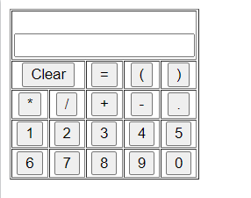
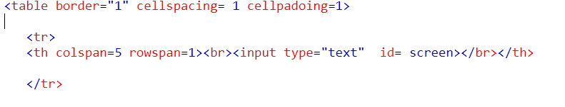
Layout:
To create this layout, we need to create a table and check the rowspan and columnspan
All the numbers and symbols should be buttons.
The buttons should print the value when clicked.

Slide 5
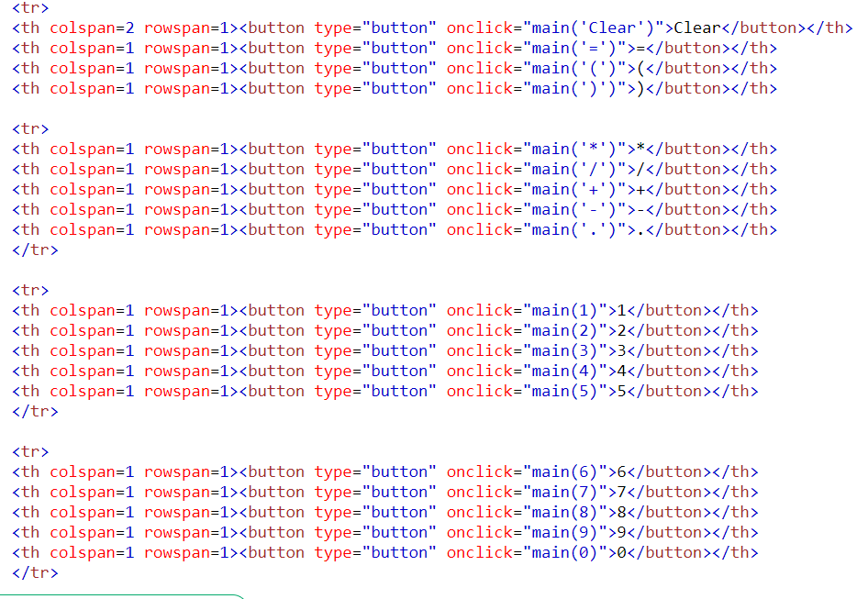
Clear should clear what was written and = should print the result of the given statement

Slide 6
Logic Code:
To print the values of digits and the symbols of the arithmetic operations, we write a logic under main function as follows.
To evaluate the given expression, we write a logic using eval() to print the result.

Slide 7
To clear the screen after evaluating, we need to print a blank space.

Slide 8
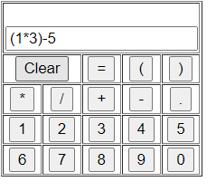
Calculator:
While clicking on the buttons to calculate the expression we need, looks as below

Slide 9
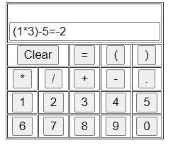
Result after clicking =, looks as follows:

Slide 10
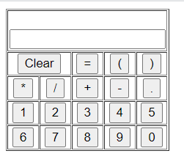
After clicking clear, it looks as the initial calculator and is ready for new calculations to be done.

